Slide 1
AWS PROJECTS
Vishal kumar S
Assistant Associate – CDE
June 15, 2023

Slide 2
Projects
01. Load and Process IPL Match Data
02. Upload EOD Transactions files into System
03. Enhancement Request: Capture transaction data from SQS queue
04. Enhancement Request: Create a Bookkeeping Serverless Application
05. Load and Process IPL Match Data
This is Enhancement Request on top of Project 1

Slide 3
Project 1
Load and Process IPL Match Data
AWS Services:
Dataset Details:
•Amazon S3 for Data Storage
•AWS Glue for Data Processing
•Dataset includes ball-by-ball information for every match played between 2008 and 2022 seasons.
•Tables: Match Details (IPL_Matches_2008_2022.csv), ball by ball details (IPL_Ball_by_Ball_2008_2022)

Slide 4
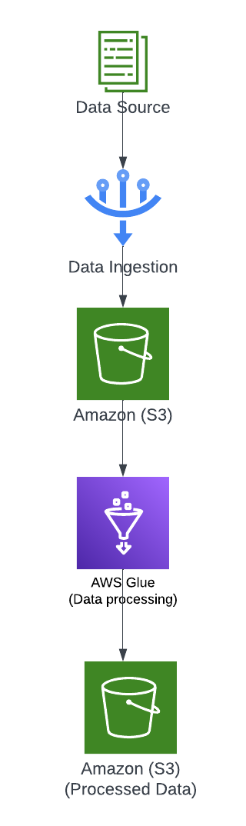
Infrastructure Setup
1.Data loaded into AWS S3 from Various Data Source.
2.Set up AWS Glue crawler to discover and catalogue the dataset files in the S3 bucket.
3.Create separate Glue ETL jobs for each requirement to extract relevant data from the dataset tables.
4.Perform data transformations and aggregations to calculate the desired statistics.
5.Sort the results based on the specified criteria (e.g., runs scored, balls faced, wickets taken).
6.Write the final results to separate CSV files for each season, following the specified naming convention.

Slide 5
Requirements: The project has multiple requirements related to IPL match data analysis. Here are the high-level descriptions of the requirements: - Requirement No 1: Fastest Centuries - Requirement No 2: Most Fours Innings - Requirement No 3: Most Runs - Requirement No 4: Most Wickets - Requirement No 5: Most Runs Conceded In Innings - Requirement No 6: Fastest Fifties - Requirement No 7: Most Sixes Innings

Slide 6
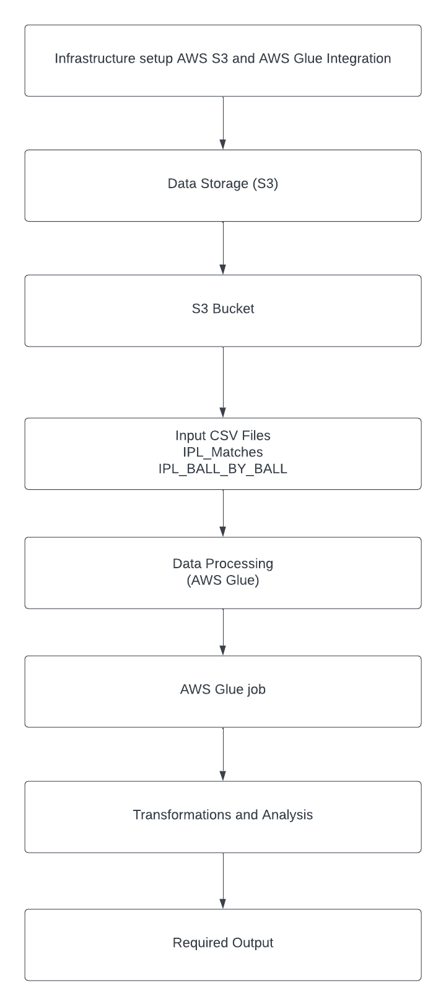
Architectural Plan
The dataset files, namely "ball-by-ball.csv" and "matches.csv", are uploaded to an AWS S3 bucket.
These dataset files serve as the data source for our AWS Glue job.
A Glue job is created to perform the required data transformations and preprocessing on the datasets.
The Glue job processes the "ball-by-ball.csv" and "matches.csv" files, applying the necessary transformations.
The output of the Glue job, which contains the desired data after preprocessing, is generated.
The resulting output is stored in the S3 bucket, making it accessible for further analysis or usage.

Slide 7
Project 2
Upload EOD Transactions files into System
AWS Services:
Dataset Details:
•AWS S3: Used to store incoming transaction files.
•AWS Lambda: Responsible for Triggering the Glue Jobs
•AWS Glue: Used for data transformations
•DynamoDB: Stores the Account Master, Source System Master data and Transaction Ledger Table
•The system will receive two types of files: Parquet and Avro.
•Each file contains transaction data from a satellite system.
•The files will be uploaded to an S3 bucket.

Slide 8
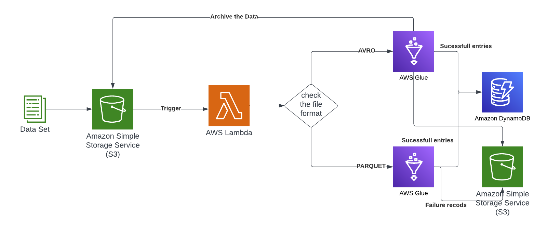
System Workflow:
8
AWS PROJECTS
June 19, 2023

Slide 9
DYNAMODB TABLES
Account Master Table
Transaction Table
Source System Master Table
•Table Name: acct_master
•Columns: acc_no (Text, Unique alphanumeric), acc_name (Text), acc_desc (Text), acc_type (Text, values: I, E, A, L)
•Table Name: ledger_txn
•Columns: txn_id (Integer, sequential auto-generated), voucher_code (Char(10), unique), txn_type (Char(1), values: D, C),
•txn_date (Date), acc_no (Foreign Key from acct_master), txn_amt (Numeric(11.2)), source_system_id (Integer, values: 1, 2),
•source_system_txn_id (Varchar(50))
•Table Name: src_sys_mst
•Columns: system_id (Integer, sequential auto-generated), system_name (Varchar(30))

Slide 10
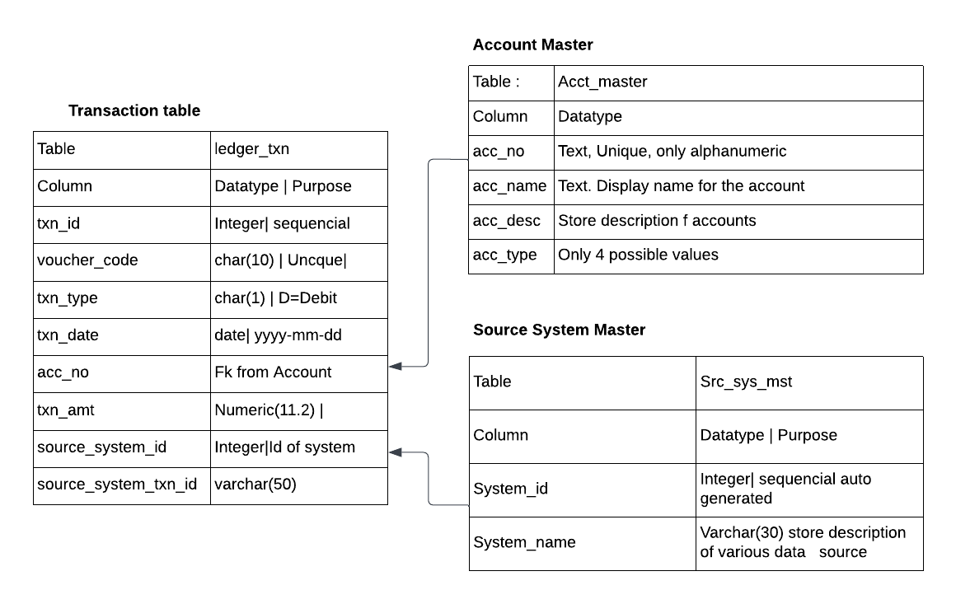
Table Structure
10
AWS PROJECTS
June 19, 2023

Slide 11
Processing Parquet File Format
Read the Parquet file from the S3 bucket.
Extract the necessary fields (trnrefid, code, tdate, trn_amount, vat, excise_duty).
Generate voucher code from trnrefid.
Create three separate transaction entries for each transaction:
Credit "Product Sale" with trn_amount.
Credit "Value Added Tax" with vat.
Credit "Excise Duty" with excise_duty.
Validate the transaction date to ensure it's not a future date.
Post the transactions to the ledger_txn table.
If any transaction fails, create a separate file for failed records.

Slide 12
Processing Avro File Format
Read the Avro file from the S3 bucket.
Extract the necessary fields (Tran_ref_id, Transaction_dt, amt, gst, custom_duty).
Generate voucher code from Tran_ref_id.
Create three separate transaction entries for each transaction:
Credit "Product Sale" with amt.
Credit an appropriate account with gst.
Credit "Custom Duty" with custom_duty.
Validate the transaction date to ensure it's not a future date.
Post the transactions to the ledger_txn table.
If any transaction fails, create a separate file for failed records

Slide 13
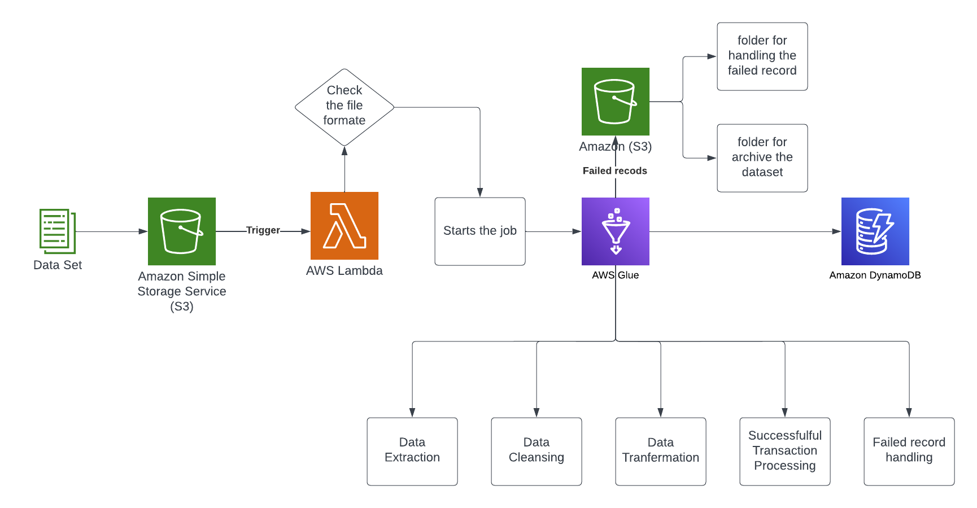
System Architecture
13
AWS PROJECTS
June 19, 2023

Slide 14
Project 3
Capture transaction data from SQS queue
AWS Services:
Dataset Details:
AWS SQS: Message queue service for receiving live transaction data from a third-party system.
AWS Lambda: Serverless compute service for processing and handling the received messages.
DynamoDB: NoSQL database for storing Account Master and Source System Master data.
Data will be pushed into (SQS)Que from Various
Sources.
Streaming Data can be pushed into Que from services like Kinesis
.

Slide 15
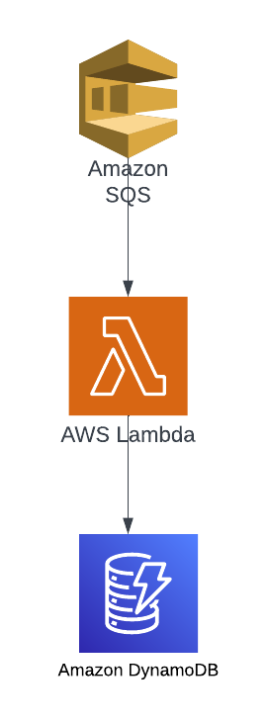
Detailed Workflow:
Third-Party System Integration:
The third-party system will post live transaction data to the SQS queue in JSON format.
The SQS queue acts as a buffer, decoupling the transaction processing from the third-party system.
Message Processing:
AWS Lambda functions are triggered by messages from the SQS queue.
The Lambda function retrieves the message from the queue.
The JSON message is parsed to extract the relevant transaction details.
Validations are performed on the transaction data.
Transaction Creation:
Based on the transaction details, three separate transactions are created for each incoming transaction.
The transactions are recorded in the Ledger Transaction table in DynamoDB.

Slide 16
Requirements: 1, Retrieval from SQS: Retrieve messages in JSON format from the SQS queue. 2. Lambda Processing: Route the messages to AWS Lambda for further processing. 3. Lambda Function Usage: Utilize AWS Lambda functions to perform serverless data processing. 4. Event Trigger: Trigger Lambda functions based on events received from the SQS queue. 5. Data Validation and Transformation: Perform necessary validation and transformation operations on the data within the Lambda functions. 6. Data Storage in DynamoDB: Store the processed data in a DynamoDB table for persistence and future retrieval.

Slide 17
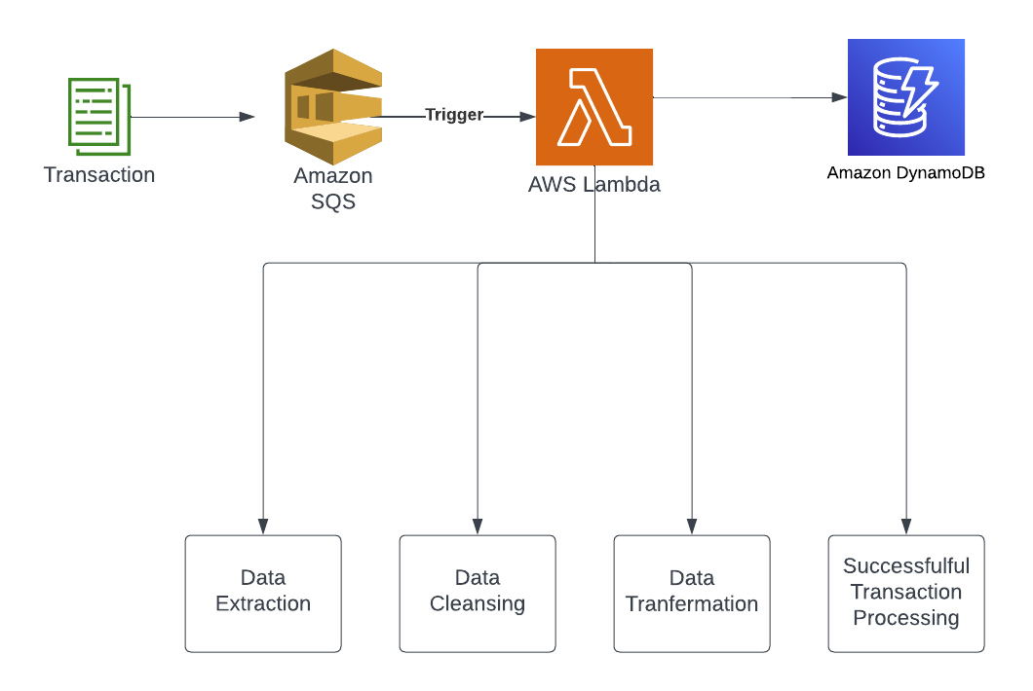
Architecture

Slide 18
Project 4
Enhancement Request: Create a Bookkeeping Serverless Application
AWS Services:
Other Technologies:
•Amazon S3 for Hosting Space
•Amazon API Gateway for interact with Services
•Amazon Lambda for Micro services
•Amazon DynamoDB for store and retrieve Data
•HTML – Front-End
•CSS - Style
•Java Script - The code is then executed by the browser when the page loads.
•AJAX - Make asynchronous requests to the server for data, and then updating the page with the new data.

Slide 19
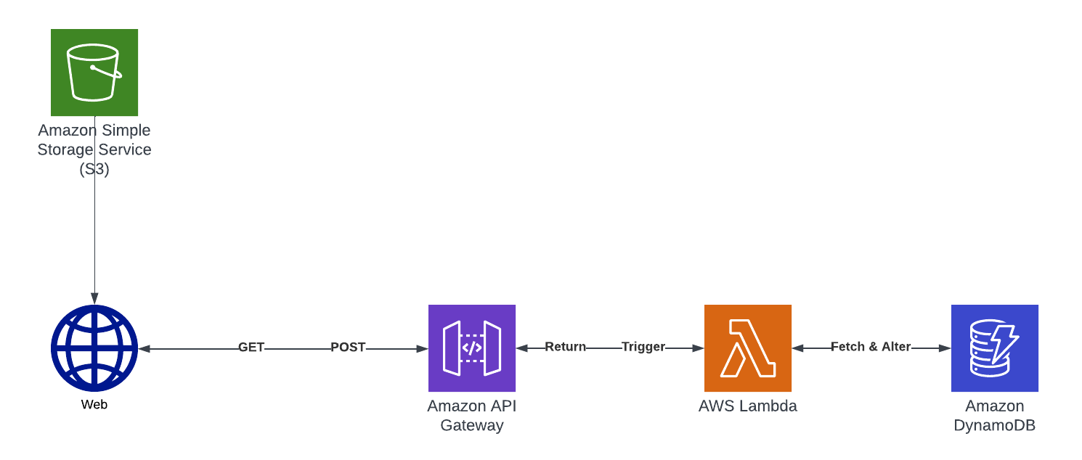
Architecture

Slide 20
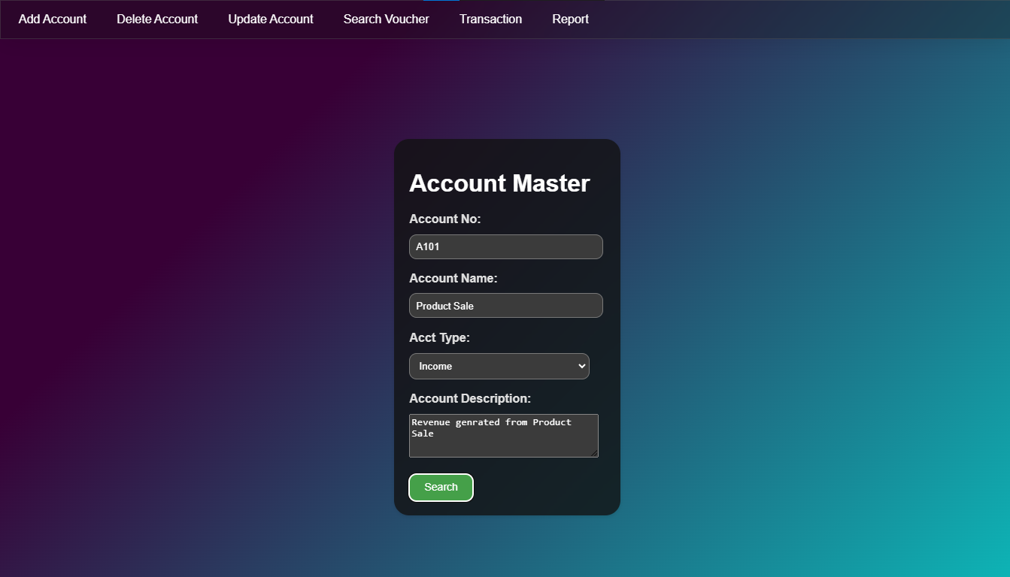
Implementation

Slide 21
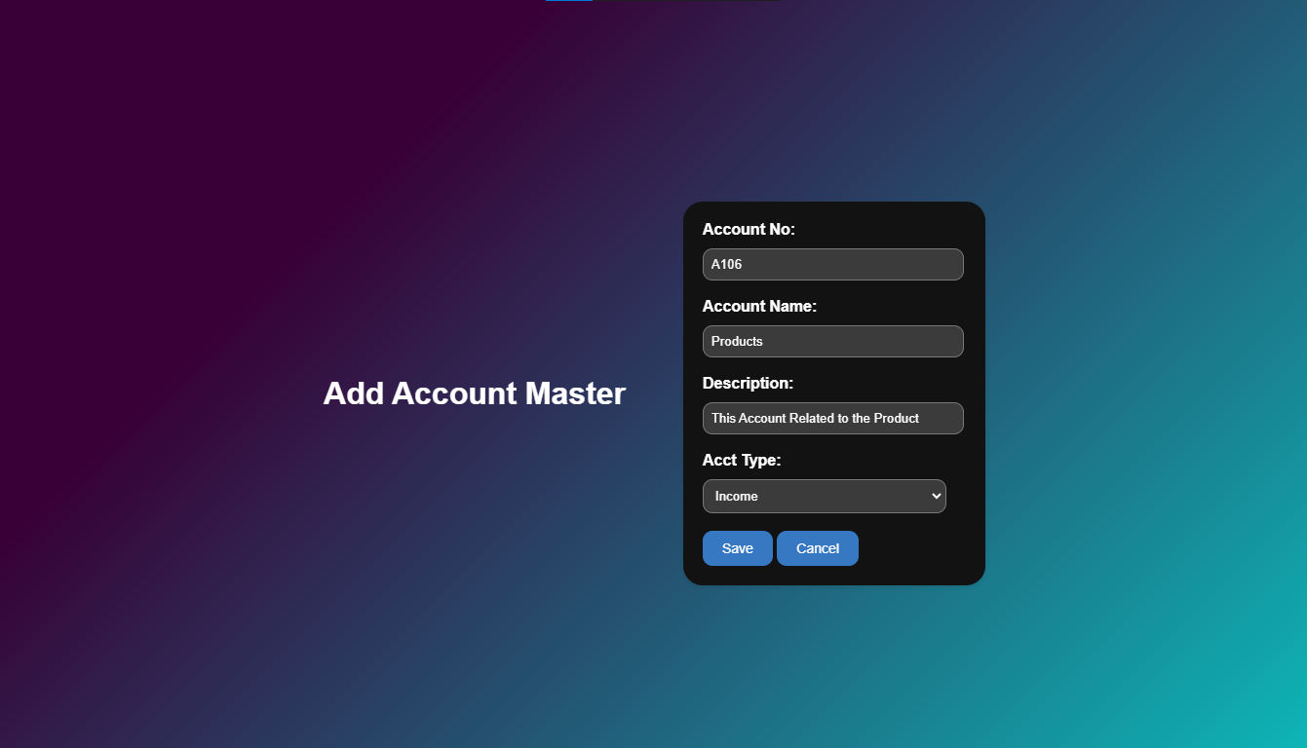

Slide 22
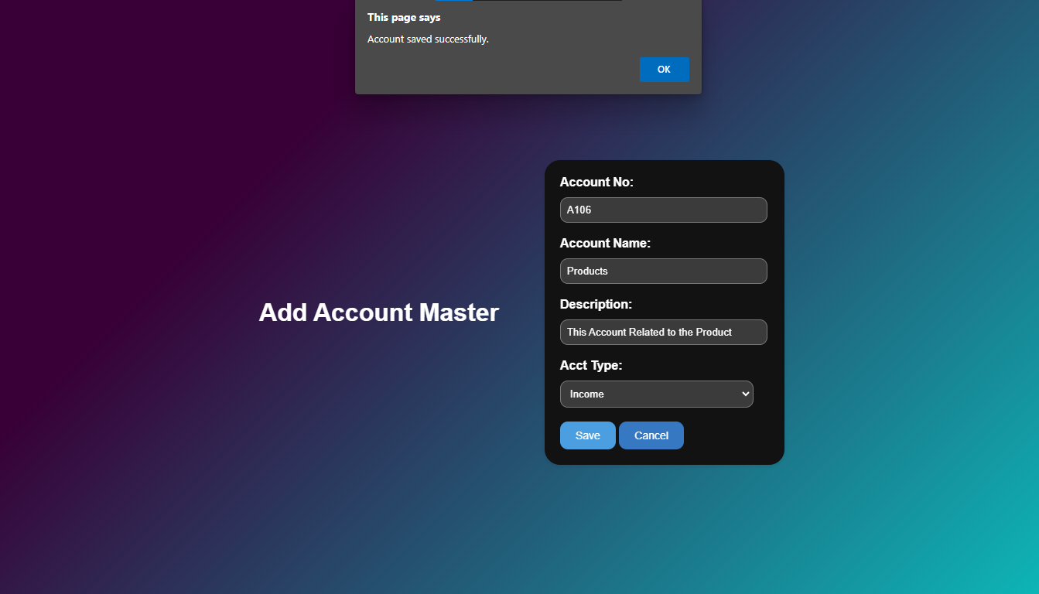

Slide 23
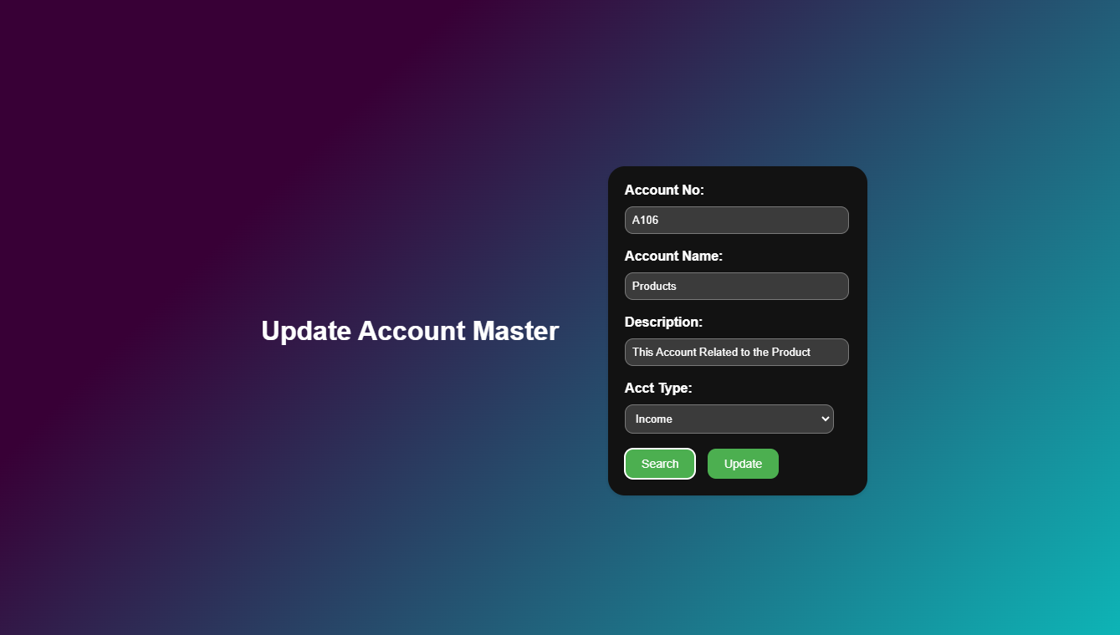

Slide 24
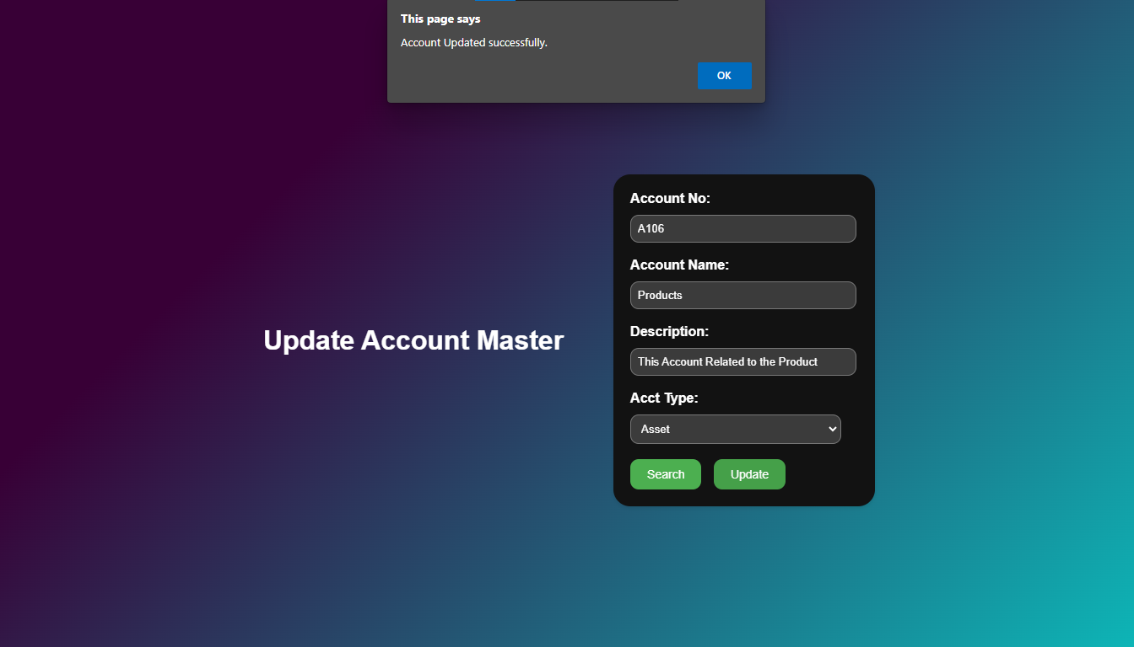

Slide 25
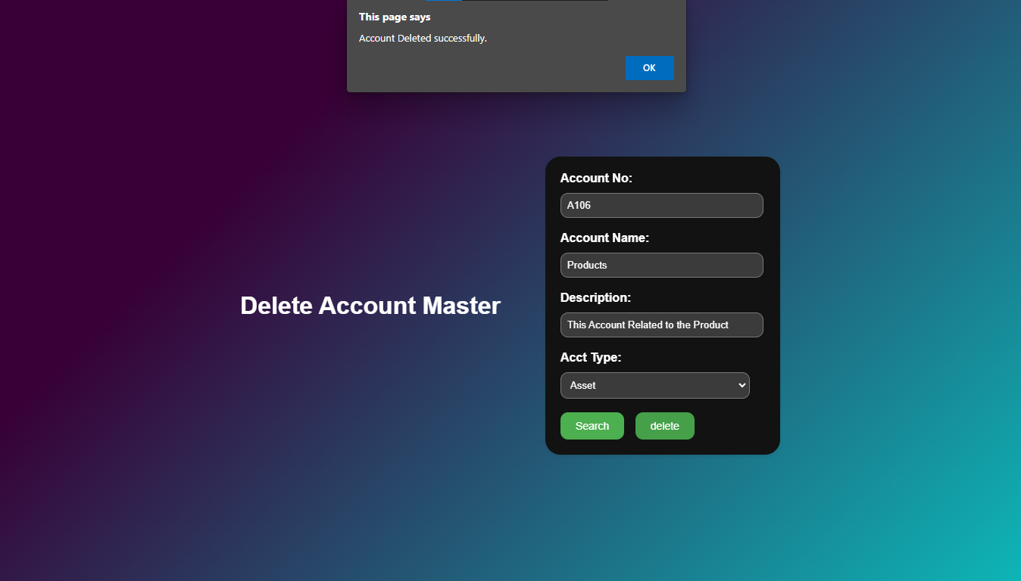

Slide 26
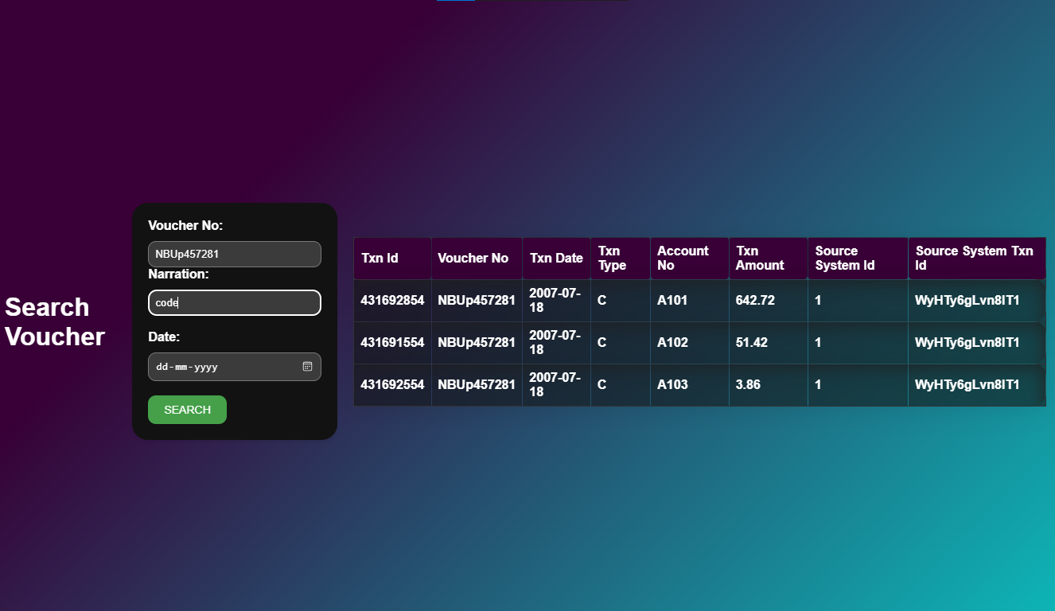

Slide 27
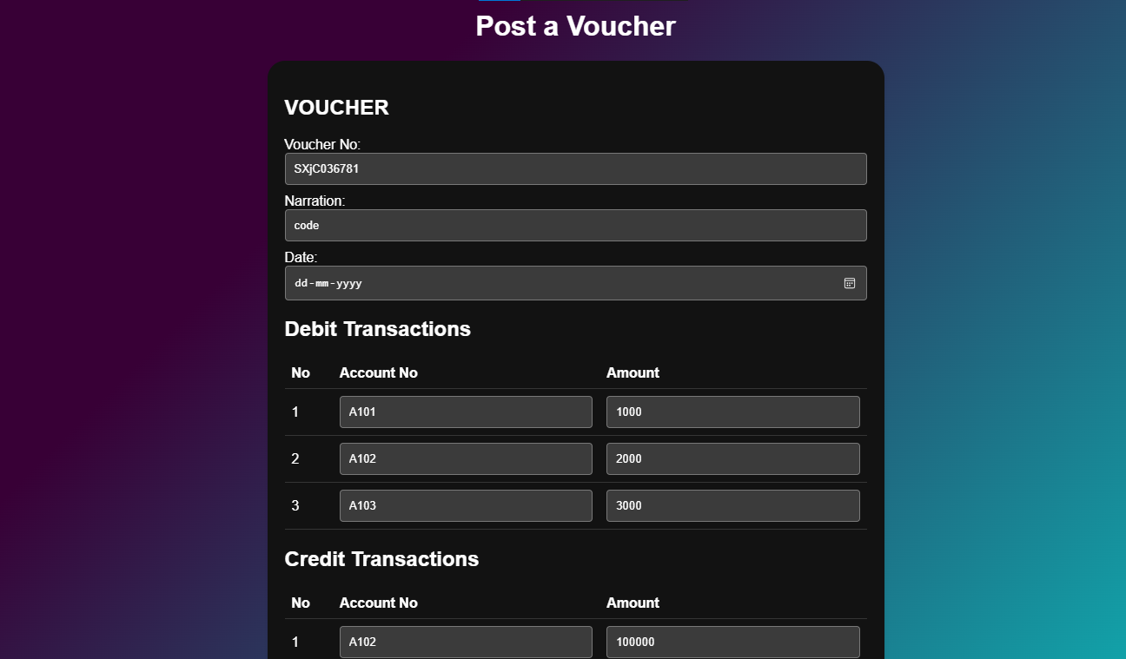

Slide 28
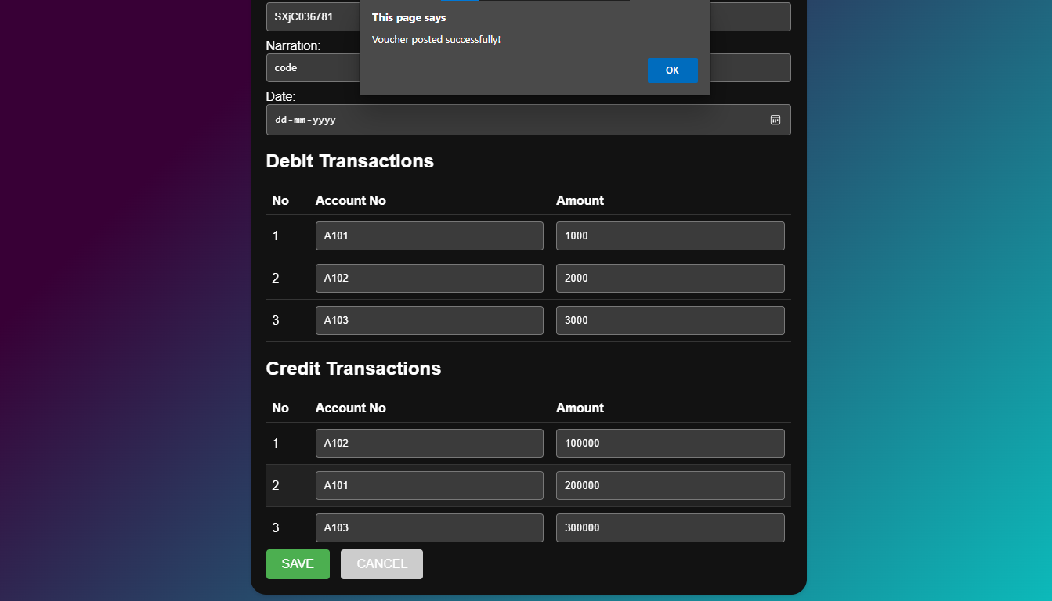

Slide 29
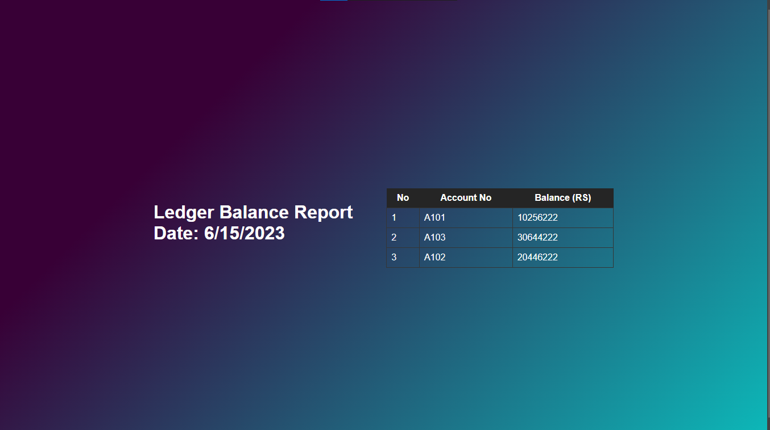

Slide 30

Thank you
Vishal Kumar S
Assistant Associate – CDE
June 15, 2023

